Slide 1
MGT388 Finance for Engineers
Lecture 10:
Sustainability reporting, business ethics, accounting information security and quality management

Slide 2
What is accountability?
“The duty to provide an account or reckoning of those actions for which one is held responsible.” (Gray et al, 1996, p.38)
Responsibility to undertake certain actions.
Responsibility to provide an account of that – disclosure.
To whom should corporations (and their management) be held accountable? Benston (1982, p. 88) identifies:
Shareholders
Stakeholders
General public / society
Primary interest of the firm (Italian tradition of Accounting)

Slide 3
Business Ethics
The profit maximisation objective should be constrained by the need for firms also to give high priority to their social responsibilities and ensure that their employees adopt high standards of ethical behaviour.
Management accountants should ensure that any business practice is legal and conform with their organisation’s Code of Ethics and the guidelines established by their professional accountancy body.
Otherwise, they should present documentary evidence indicating that such actions should not be undertaken.

Slide 4
Corporate Social Responsibility (CSR)
Corporate social responsibility (CSR) is the notion that a company has responsibility to society that go beyond its legal obligations and its duties to shareholders. In the UK, CSR is a part of Corporate Governance (Companies Act 2006).
CSR includes the company’s impact on the environment, any ethical issues arising from its trading or investment practices, and the policies of the company internally (e.g. transparency, fair and equal treatment of employees).
Triple bottom-line accounting (TBL): a method of measuring a company’s social and environmental impact in addition to its economic value (since1994). It seeks to appraise not only the conventional ‘bottom line’ of economic profit and loss, but also a company’s ‘people account’ and its ‘planet account’.

Slide 5
Social reporting
Social responsibility reporting (corporate social reporting or social reporting): the reporting of social accounting issues by a business.
This may be discussed in the annual accounts and report or form the basis of a separate report. The monetary quantification of social benefits is much harder to measure and necessarily subjective.
Social responsibility costs e.g. charitable donations of equipment and time, education inititives (such as sponsorships and research funding), product safety, community involvement, employment of disadvantaged groups, provision of sports equipment or sponsorship.
Social audit: an audit of the impact of an organisation on society (audit can be conducted internally or externally by social consultants).

Slide 6
Environmental reporting
Green reporting (environmental reporting or accounting): a report by the directors of a company that attempts to quantify the costs and benefits of that company’s operations in relation to the environment.
This may be discussed in the annual accounts and report or form the basis of a separate report.
Environmental audit: an audit of the impact of an organisation on the environment. Its purpose is usually to ensure that the organisation has clear environmental policies, that its operations comply with the stated environmental policies, and that its policies are subject to regular review (audit can be conducted internally or externally by environmental consultants).

Slide 7
Environmental costs
Environmental management accounting focuses on managing excalating environmental costs arising from meeting regulatory requirements and seeking to avoid litigation and fines.
It includes the tracking and reporting of environmental costs, input-output analysis and periodically producing an environmental cost report.
Environmental costs: the costs of making sure that a company’s activities do not damage the environment or that any such damage is put right. They are frequently hidden on overheads. National regulations become more stringent and penalties or fines more severe.

Slide 8
Environmental costs
It is useful to classify environmental costs into four categories:
Environmental appraisal (detection) costs: to monitor environmental effects that a firm is responsible for. E.g. inspection of products and contamination testing.
Environmental prevention costs: to prevent the production of waste that could cause damage to the environment. E.g. recycling products, training staff, carrying our environmental studies.

Slide 9
Environmental costs
It is useful to classify environmental costs into four categories:
Environmental internal failure costs: costs of the activities to be performed when contaminants and waste have been produced by a company but not discharged into the environment. E.g. Treating toxic waste and maintaining pollution equipment.
Environmental external failure costs: costs incurred by a company if it discharges waste into the environment. E.g. Cleaning up oil spills or polluted river. Also, fines or other penalties or loss of sales due to a poor environmental reputation.

Slide 10
What is sustainable development?
“Sustainable development is development that meets the needs of the present without compromising the ability of future generations to meet their own needs.” (World Commission on Environment and Development, 1987, p.54).

Slide 11
What has sustainability got to do with accounting?
Traditional accounting model tends to focus on financial/economic performance
Financial statements
Wider social and environmental impact of organisational activities are not reflected in financial statements
Need for sustainability accounting or (better) accounting for sustainability
It helps to hold the organisations to account for their sustainability related performance
Sustainability report

Slide 12
Sustainability reporting
It provides information about the economic, environmental and social performance of an entity.
Tied to the concept and goal of sustainable development.
New and continually evolving area.
It may contain financial information, but it is more likely to be a combination of quantified non-financial information and descriptive, non-quantified information.

Slide 13
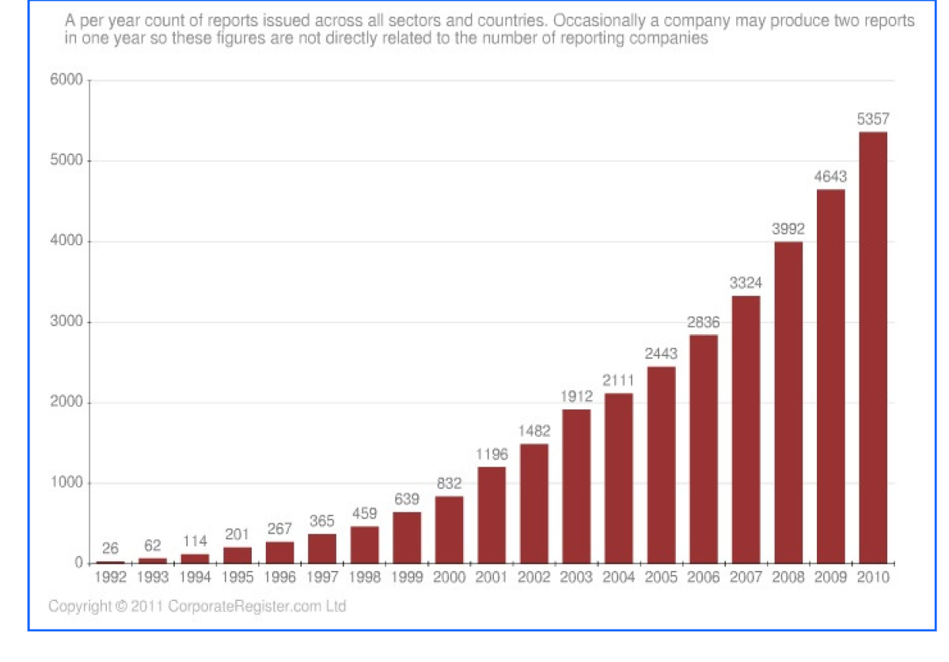
Sustainability reporting trend: 1992-2010

Slide 14
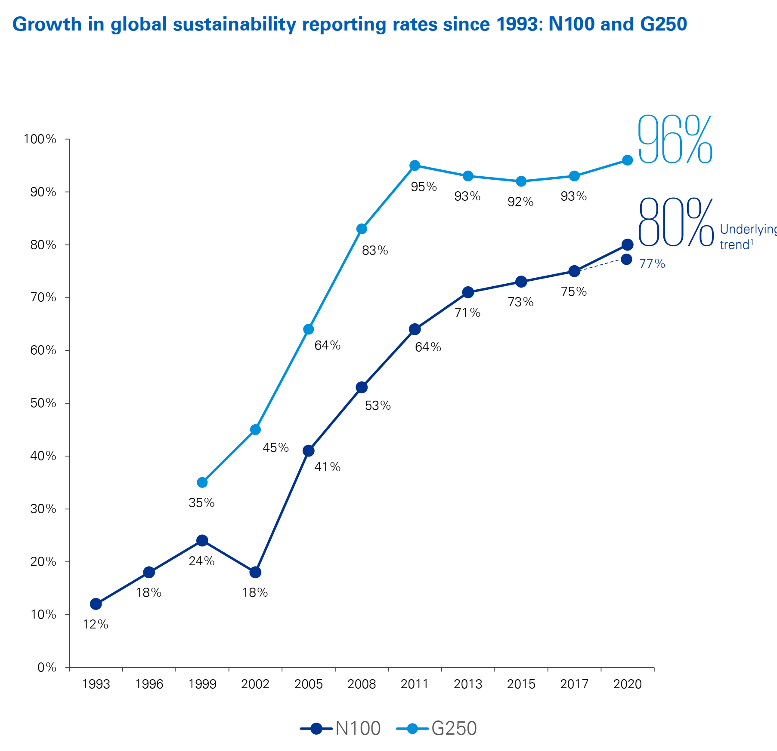
What are companies doing?
Source: KPMG, 2020
The N100 refers to a worldwide sample of 5,200 companies comprising the top 100 companies by revenue in each of the 52 countries researched in this study. These N100 statistics provide a broad- based snapshot of CR reporting among both large and mid-cap firms around the world.
The G250 refers to the world's 250 largest companies by revenue based on the Fortune 500 ranking of 2016. Large global companies are typically leaders in CR reporting and their behavior often predicts trends that are subsequently adopted more widely.

Slide 15
2030 Agenda for SD
Sustainable Development: “An approach to progress which meets the needs of the present generations without compromising the ability of future generations to meet their own needs” (World Commission on Environment and Development, 1987).
The 2030 Agenda for Sustainable Development, adopted by all United Nations Member States in 2015, provides a shared blueprint for peace and prosperity for people and the planet, now and into the future.
The 17 Sustainable Development Goals (SDGs) are an urgent call for action by all countries - developed and developing - in a global partnership.

Slide 16

17 Sustainable Development Goals (SDGs)
Companies are encouraged to adopt sustainable practices and integrate sustainability information into their reporting, so they can understand, communicate, and better manage their contributions to the 17 SDGs.

Slide 17
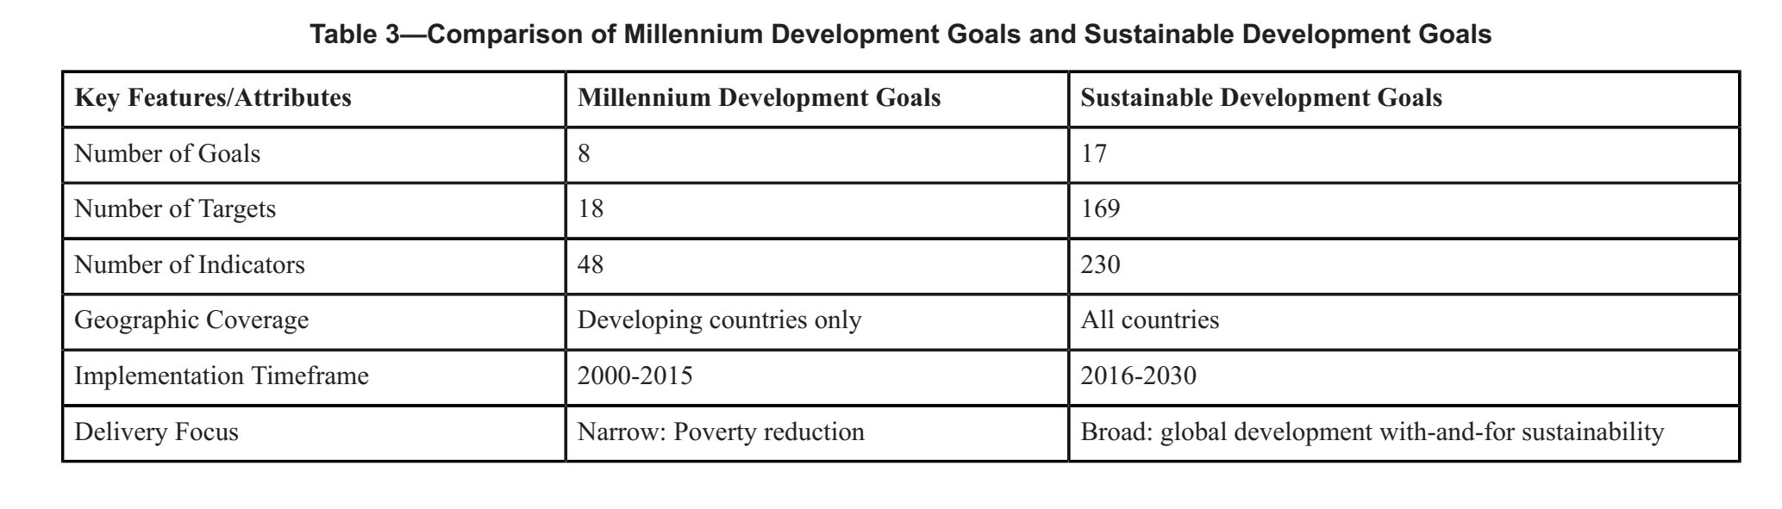
MDGs vs SDGs
Source: Ite, 2018
SDG Tracker: https://ourworldindata.org/sdgs

Slide 18
What is accounting today?
Accounting is a technical, social and moral practice concerned with the sustainable utilisation of resources and proper accountability to stakeholders to enable the flourishing of organisations, people and nature.
Carnegie, G., Parker, L. and Tsahuridu, E. (2021), It's 2020: What is Accounting Today?. Australian Accounting Review, 31: 65-73. https://doi.org/10.1111/auar.12325

Slide 19
Taxonomy of Sustainable accounting standards
Difficult to classify: significant overlaps and complementary
There are so many – which one to adopt and implement?
Process standards (AA1000, ISO26000)
Reporting standards (GRI guidelines/SASB/ISSB)
Principle-based standards (UNGC, OECD guidelines)
Certification standards (SA8000, ISO 14001)

Slide 20
Global Reporting Initiative (GRI)
The Global Reporting Initiative (GRI) has developed a Sustainability Reporting Framework for companies and aims to make its use standard practice.
Sustainability reporting is the disclosure and communication of environmental, social, and governance (ESG) goals—as well as a company's progress towards them.
The GRI Standards are widely used by all types of organisations, including companies to inform all stakeholders, including investors, labor, civil society and governments.
https://www.globalreporting.org/

Slide 21
SASB Standards
The Sustainability Accounting Standards Board (SASB) issued SASB Standards to guide the disclosure of financially material sustainability information by companies to global investors.
Available for 77 industries, SASB Standards identify the subset of environmental, social, and governance (ESG) issues most relevant to financial performance in each industry.
In August 2022, the IFRS foundation assumed responsibility for SASB Standards. The IFRS Foundation’s International Sustainability Standards Board (ISSB) encourages companies and investors to continue to support and use the SASB Standards until they are replaced by IFRS Sustainability Disclosure Standards.
https://sasb.org/standards/

Slide 22
IFRS Foundation and ISSB
COP26 (UN climate change conference) took place in Glasgow from 31 October–12 November. On 3 November, the IFRS Foundation Trustees announced the creation of a new standard-setting board—the International Sustainability Standards Board (ISSB)—to help meet this demand.
The intention is for the ISSB to deliver a comprehensive global baseline of sustainability-related disclosure standards that provide investors and other capital market participants with information about companies’ sustainability-related risks and opportunities to help them make informed decisions.
ISSB works in close cooperation with the IASB, is responsible for developing IFRS Sustainability Disclosure Standards (ISSB published the first two standards in 2023).
https://www.ifrs.org/groups/international-sustainability-standards-board/
https://www.ifrs.org/news-and-events/news/2023/12/issb-at-cop28-statement-of-support/

Slide 23
Example for corporate practice
SDG reporting by Unilever
https://www.unilever.com/sustainable-living/our-strategy/un-sustainable-development-goals/
See how effectively it meets the information needs of various stakeholders.

Slide 24
Critique of current standardisation initiatives
Adoption of these codes and standards might act as a ‘seal of approval’ without changing corporate behaviour on the ground.
Consequence: adoption in forms but not in function/substance (decoupling, Behnam & MacLean, 2011).
Most of these standards were developed from the Western context and inadequately address the developing country realities on the ground, e.g. Child labour (Belal & Owen, 2007)
Voluntary nature of these standards
Consequence: Cherry picking, incompleteness (Belal, 2002)
Clarity of some of the standards
Cost of adoption
Absence of sanction mechanisms
Lack of assurance/credibility
Comparatively silent on corporate governance reforms

Slide 25
Accounting Information Security
Management accountants are advisers and internal consultants to the business, more involved in interpreting the information generated from the IT systems and providing business support for managers.
Accounting information security is a top management responsibility, not really just a bookkeeping or IT problem.
Accounting information systems contain confidential and private information that can become compromised if left unprotected.

Slide 26
Accounting Information Security
Unauthorized use of an accounting system can be disastrous, risking loss of information, bad data input and misuse of confidential information.
The risks with accounting systems are real. Some examples:
Theft of social security numbers from employees and contractors
Payments to fake vendors
Data deletion/loss
Damage to backup tapes
Theft of servers or computers.

Slide 27
Accounting Information Security
Security measures are also known as controls, and they can be preventive, to prevent risks, or detective, to identify problems after the fact. Once risks are identified, the controls can be set up to protect the system.
Some security measures are:
Frequent password changes
Encryption of data
Monthly supervisor review of vendor reports
Safe and protected server and computer environment
Safe and protected off-site archiving of backup tapes.

Slide 28

Total quality management
Where are we?
Where do we want to go?
Continuous Improvement
Plan
Do we need to change the plan?
How do we start?
Act
is
Do
Check
Benchmarking
Blocher et al 2005
How are we doing?

Slide 29
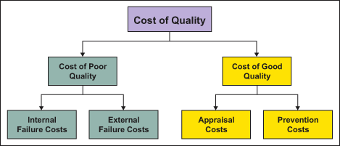
Total quality management
By increasing the appraisal and prevention costs (cost of good quality), companies can reduce the internal and external failure costs (cost of poor quality).

Slide 30
Study for MCQ test
MCQ test detailed guidance provided in Blackboard (see ‘Examination’ on the left sidebar)
Check the date, time and place in the UoS Central Timetable.
Formative tests for Law and Finance are available in Blackboard.
A mock exam for the Finance component will be available next week (not available for Law).
Cover all topics (lectures, workshops, lecture notes and Q&As).
Ask questions in the Discussion Board and in the Q&As session in Blackboard Collaborate w/c 8th January (the precise date will be communicated asap). This additional session (optional) is offered by the Module Leader to support you in preparing for the exam.

